Slide 1
Lesson objective
Title: Area of basic shapes
Aim:
Convert units of measurement using written strategies
Substitute into formula to calculate area of triangles
Plan:
Daily review
Converting
Exploring formula
Need whiteboards and calculators.

Slide 2
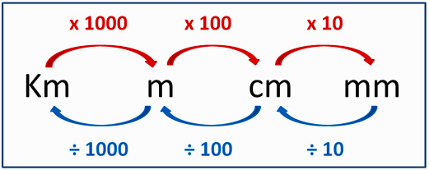
Converting length units
Reteach
How many zeros you got?
Move that spot!
4m = _______cm
3000m = _______ km
5m = _________mm
1 000 000mm = _______ km

Slide 3
Converting units WITHOUT a calculator
Multiplication (big unit to small)
Division (small unit to big)
1km (x 1000) = 1000m
4m (x 100) = 400cm
8cm (x 10) = 80mm
2000m (÷ 1000) = 2km
300cm (÷ 100) = 3m
40mm (÷ 10) = 4cm
Notice the decimal point changes position with every zero

Slide 4
Converting units (look at your notes)
When we divide or multiply by 10, 100 or 1000 we can use this trick to make it easy.
We simply move the decimal point a place value for every zero….
But what does that mean?
E.g. Change 8cm to mm
E.g. Change 1345m to km
Step 1: identify if its divide or multiply
Step 2: identify by how much (10, 100 or 1000)
Step 3: move the decimal (left or right)

Slide 5
Converting measurements
I do
You do (whiteboards)
125cm to m:
43cm to mm:
8cm to mm:
800mm to cm:
3m to cm
90mm to cm
1350m to km
85mm to cm

Slide 6
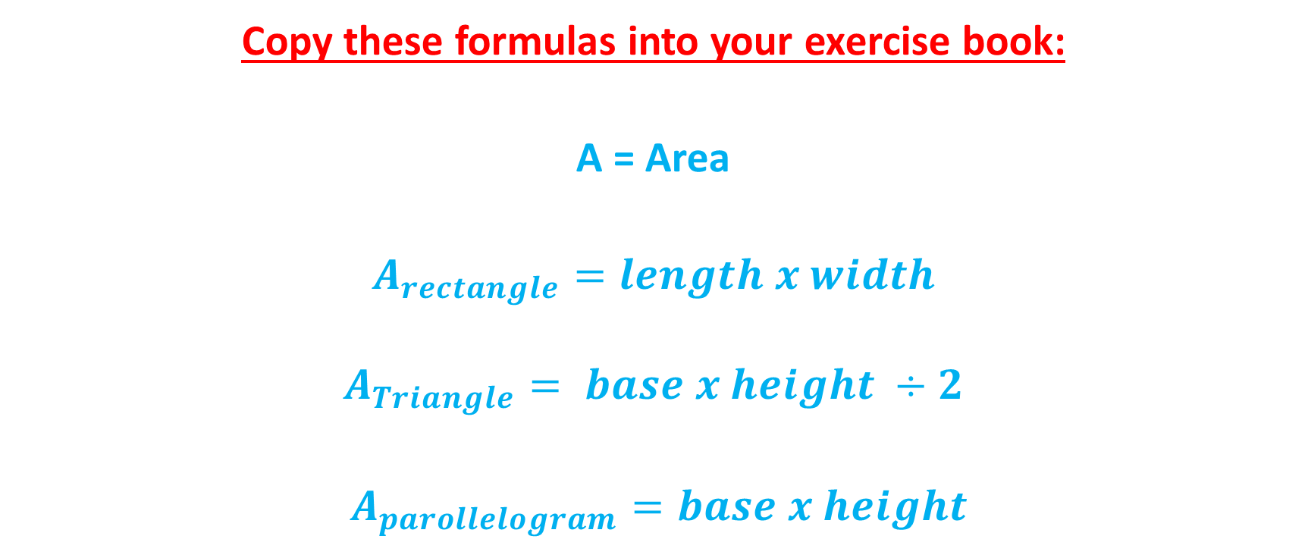
Area: start with formulas
Copy these formulas into your exercise book:
A = Area
$A_{rectangle}=length x width$
$$A_{Triangle}= base x height ÷2$$
$A_{parollelogram}=base x height$

Slide 7
The perimeter is:
The total length forming the boundary of a closed geometrical figure.
The ____ length forming the boundary of a closed geometrical figure.
The ____ length forming the ________ of a closed geometrical figure.
What is the line forming a boundary of a shape called?

Slide 8
Area of triangles
Area is the total space within the perimeter.
Always remember
Diagram
Rule
Numbers
Solve
$$A=0.5 ×b ×h$$
$=0.5 ×12 ×8$
$$= {42cm}^{2}$$
8cm
12cm

Slide 9
Area of shapes.
Height and base must always be perpendicular.
Perpendicular means lines meet at $90°$

Slide 10
We do
Always remember
Diagram
Rule
Numbers
Solve
$$A=0.5 ×b ×h$$
3km
4km

Slide 11
We do
Always remember
Diagram
Rule
Numbers
Solve
$$A=$$
12m
6m
10m

Slide 12
Whiteboards
Always remember
Diagram
Rule
Numbers
Solve
7m
11m

Slide 13
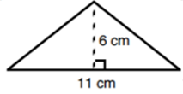
Whiteboards
Always remember
Diagram
Rule
Numbers
Solve

Slide 14
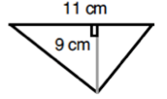
Whiteboards
Always remember
Diagram
Rule
Numbers
Solve

Slide 15
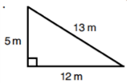
Whiteboards
Always remember
Diagram
Rule
Numbers
Solve

Slide 16

3
Answers:
140cm²
56cm²
180cm²
192cm²
132cm²
240cm²
330cm²
72cm²
72cm²
180cm²
2
1
15cm
14cm
Draw the shape
Write the rule
Put the numbers in
Solve
8cm
4
10cm
7cm
12cm
14cm
5
6
7
9cm
12cm
12cm
11cm
15cm
11cm
30cm
20cm
9
8
10
14cm
12cm
18cm
9cm
16cm
12cm
20cm

